Slide 1
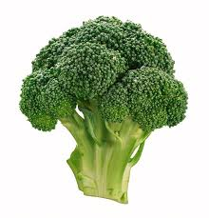
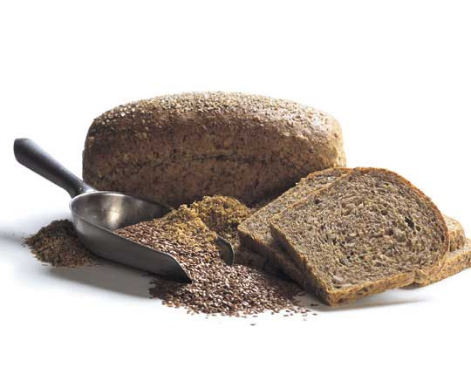
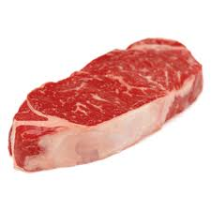
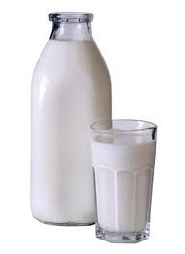
Canada’s Food Guide
Term 1 Project

Slide 2
Part 1: CFG Online Handout
Follow the directions on the worksheet carefully
Answer the questions in numerical order
Make sure you provide THOROUGH and COMPLETE answers to get full marks

Slide 3
Part 2: Food Record
Keep track of what you eat over the course of 1 complete day
Calculate how many servings you obtained from each food group
Compare your daily totals to the # of servings recommended by the CFG
Answer the reflection questions in full sentences

Slide 6
EXAMPLE

Slide 8
Part 3: Canada Food Guide Picture Book
You are to make a book illustrating the FOUR FOOD GROUPS to explain how to eat to be healthy to a PRIMARY grade student.
Because they are just beginning to read this must be done using more pictures than words.
Please be sure to make your PRINTING fairly large so that they can read it easily.

Slide 9
In this book you must include the following:
The Food Group labelled correctly
The number of servings which are required each day for each group
A brief written description of the functions of the foods in the body and the main nutrients provided by each food group.
Illustrate each Food Group completely. For example, for the Meat and Alternative group you would include meat, fish, poultry, eggs, nuts, dried beans/peas/lentils and seeds.

Slide 10
Canada Food Guide Picture Book Format
The cover of the book is very important as it will be the first thing seen.
If it is not appealing the book may never be read.
Remember to choose a theme which you will use throughout the book.
You may wish to use coloured paper or construction paper.
Remember to make this attractive and appealing to 5 to 8 year olds.

